Slide 1


SQL CHALLENGE
STRANGER THINGS
Prepared By
Dhananjay Nimje

Slide 2

ABOUT THE CHALLENGE
In this Challenge, We have to find out following Questions?
Retrieve the names of the characters?
Find characters with age greater than 18?
Find events in Season 2?
Get details of the 'Mind Flayer' monster?
Retrieve characters and their associated events?
Calculate the total number of characters from each hometown?
Retrieve characters who were involved in events in Season 1 or Season 2?
Find the top 3 oldest characters?
Find the average age of characters in Hawkins?
Rank characters by age in descending order?

Slide 3
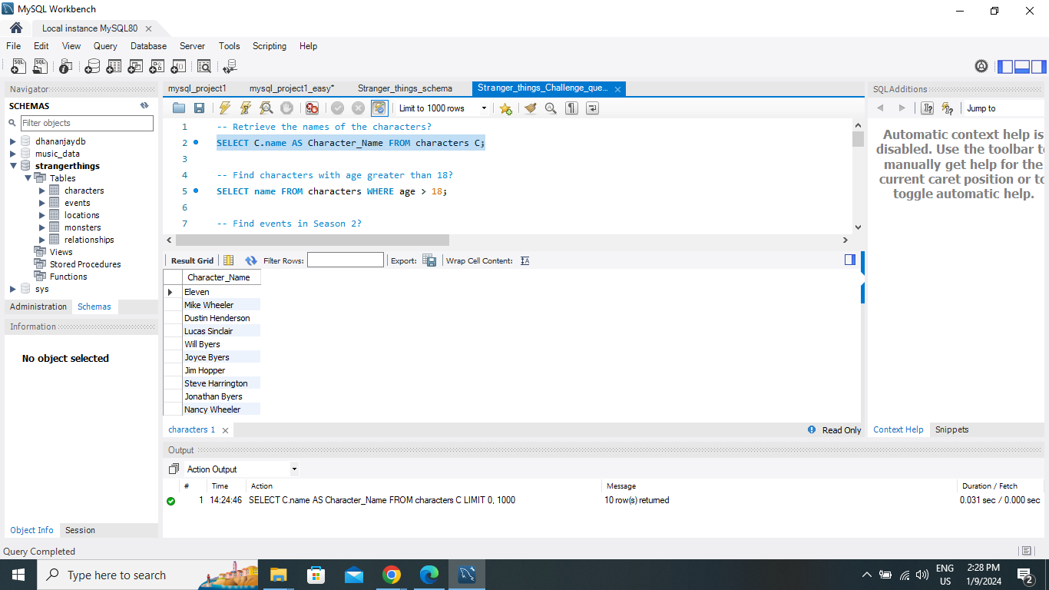
Retrieve the names of the characters?
OUTPUT
SELECT C.name AS Character_Name FROM characters C;
Prepared by
Dhananjay Nimje

Slide 4
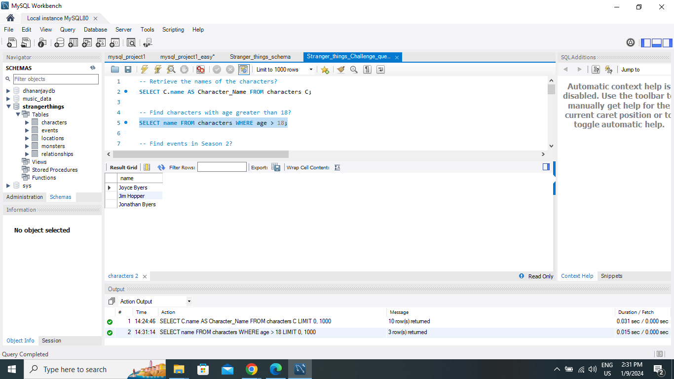
Find characters with age greater than 18?
OUTPUT
SELECT name FROM characters WHERE age > 18;
Prepared by
Dhananjay Nimje

Slide 5
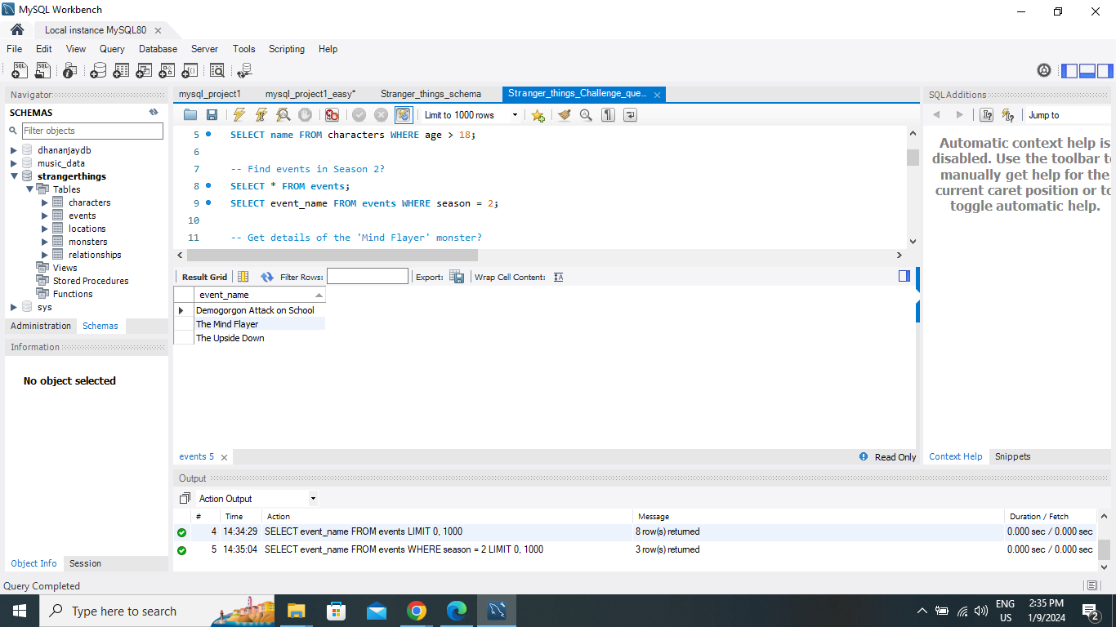
Find events in Season 2?
OUTPUT
SELECT event_name FROM events WHERE season = 2;
Prepared by
Dhananjay Nimje

Slide 6
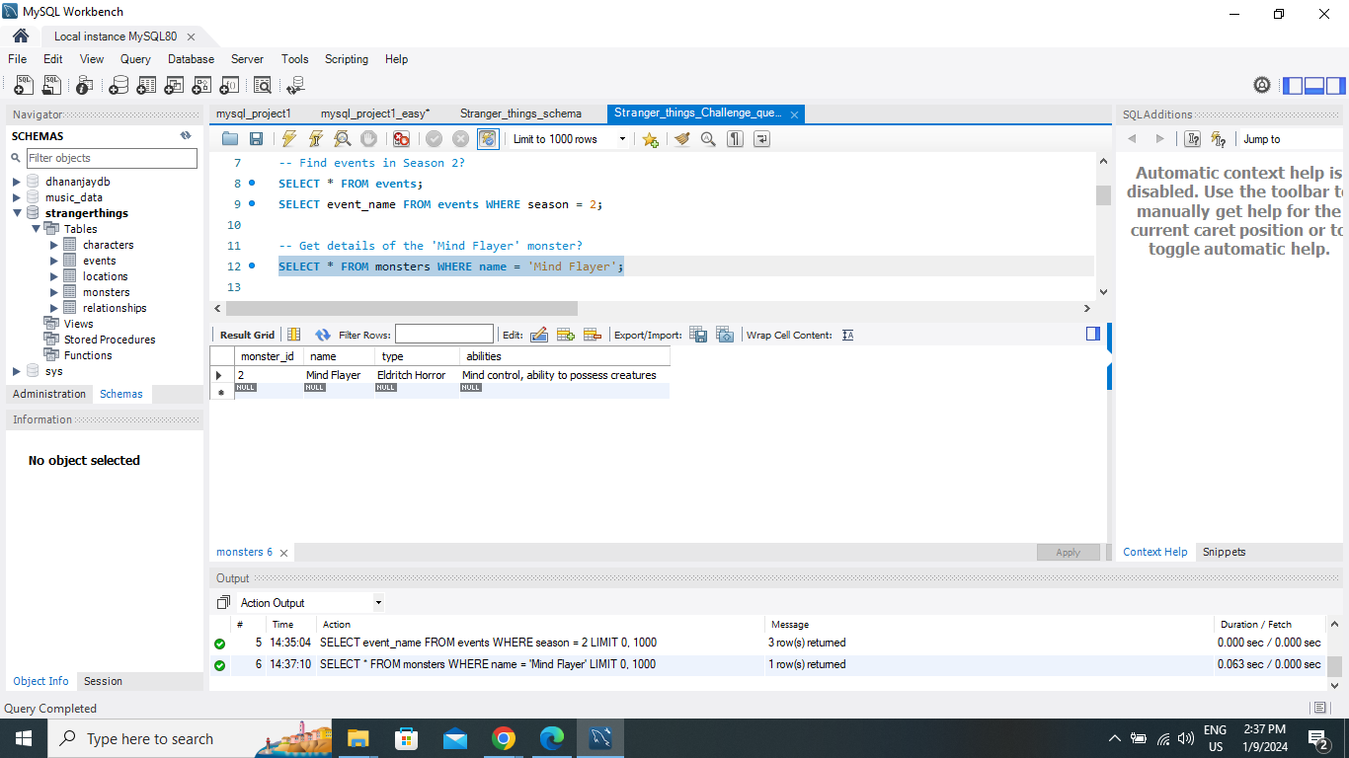
Get details of the 'Mind Flayer' monster?
OUTPUT
SELECT * FROM monsters
WHERE name = 'Mind Flayer';
Prepared by
Dhananjay Nimje

Slide 7
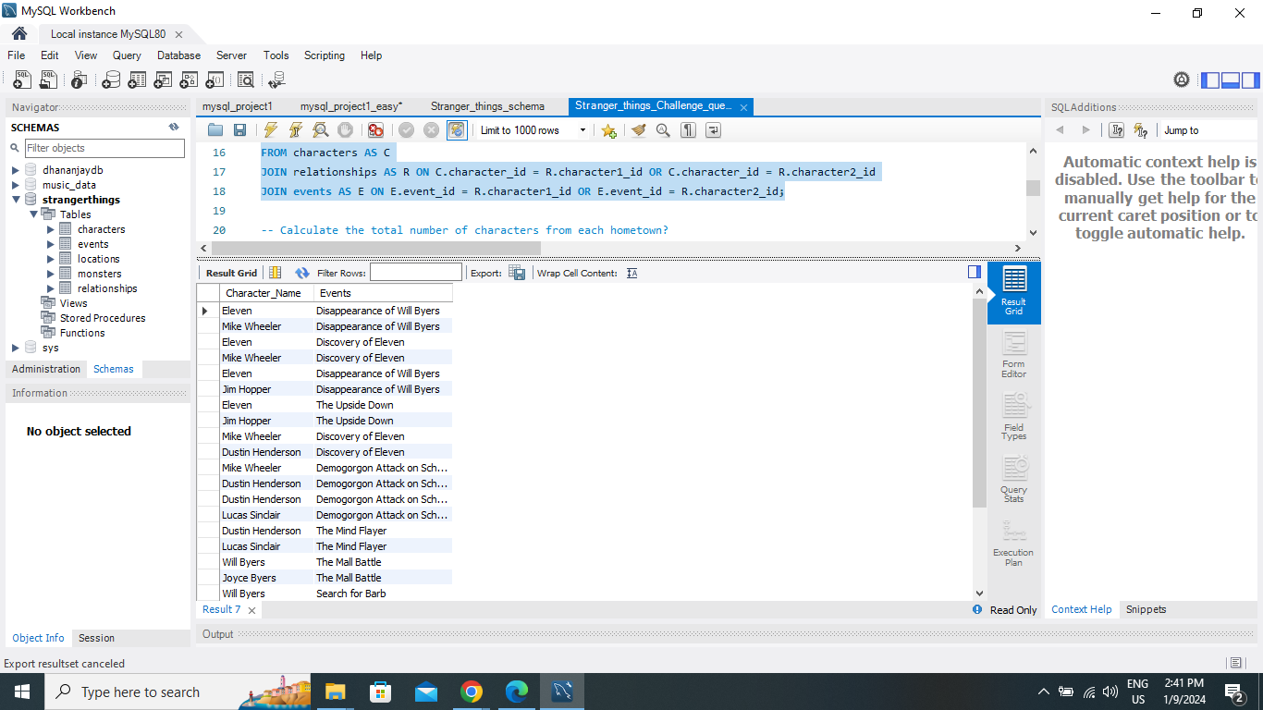
Retrieve characters and their associated events?
OUTPUT
SELECT C.name AS Character_Name, E.event_name AS Events
FROM characters AS C
JOIN relationships AS R ON C.character_id = R.character1_id OR C.character_id = R.character2_id
JOIN events AS E ON E.event_id = R.character1_id OR E.event_id = R.character2_id;
Prepared by
Dhananjay Nimje

Slide 8
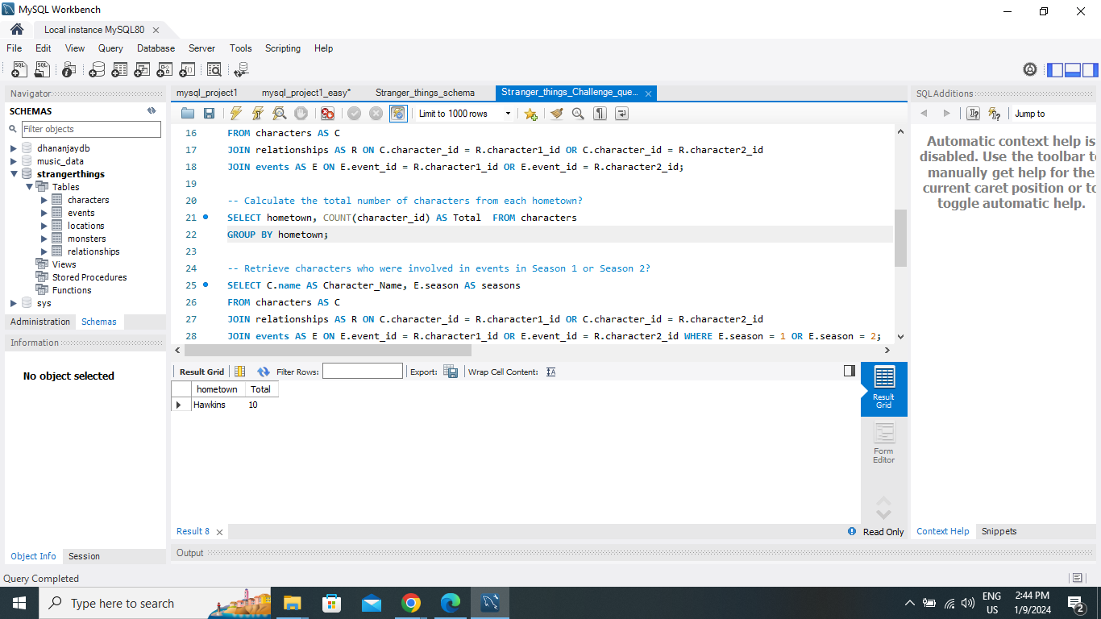
Calculate the total number of characters from each hometown?
OUTPUT
SELECT hometown, COUNT(character_id) AS Total FROM characters
GROUP BY hometown;
Prepared by
Dhananjay Nimje

Slide 9
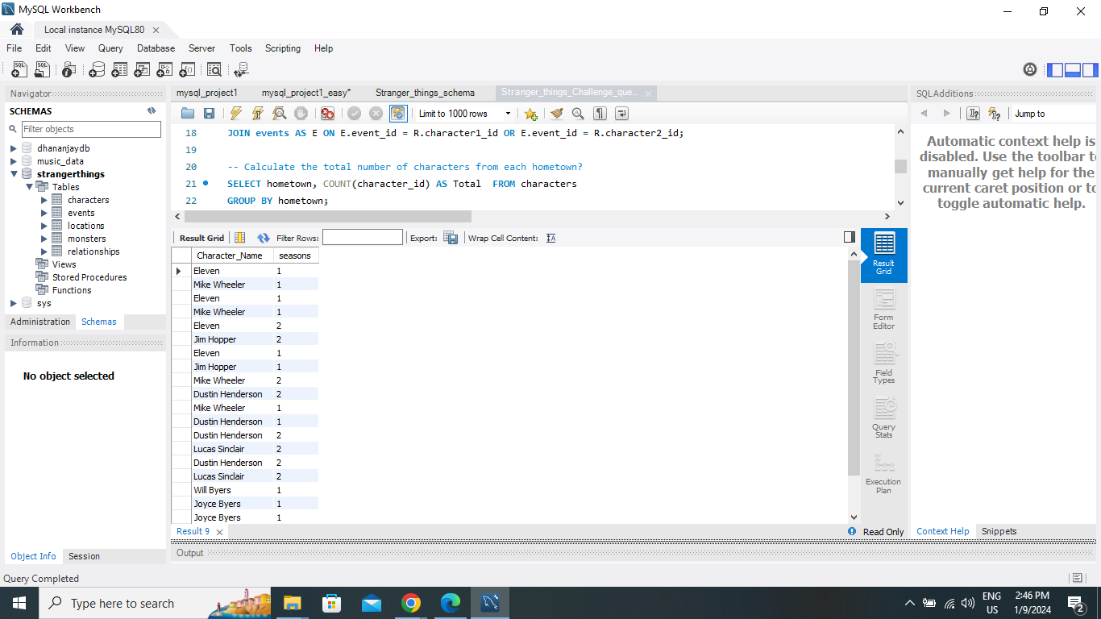
Retrieve characters who were involved in events in Season 1 or Season 2?
OUTPUT
SELECT C.name AS Character_Name, E.season AS seasons
FROM characters AS C
JOIN relationships AS R ON C.character_id = R.character1_id OR C.character_id = R.character2_id
JOIN events AS E ON E.event_id = R.character1_id OR E.event_id = R.character2_id WHERE E.season = 1 OR E.season = 2;
Prepared by
Dhananjay Nimje

Slide 10
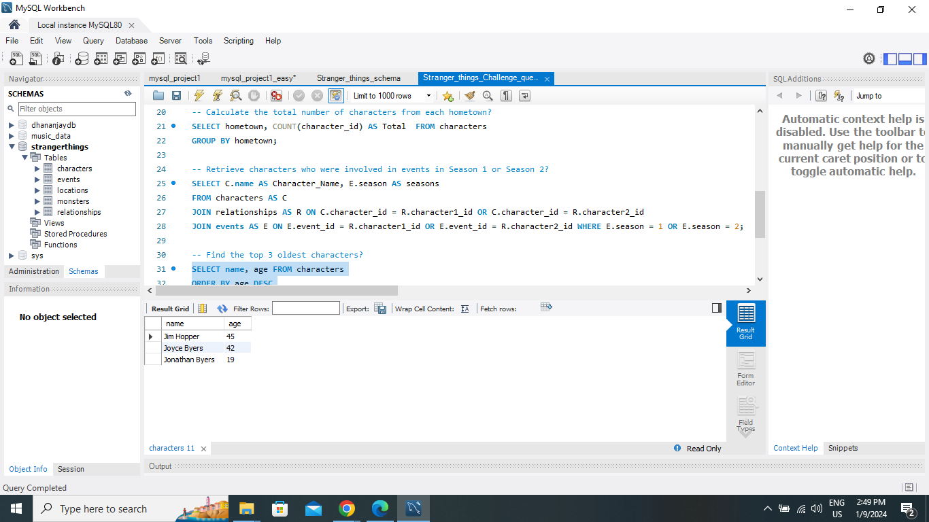
Find the top 3 oldest characters?
OUTPUT
SELECT name, age FROM characters
ORDER BY age DESC
LIMIT 3
Prepared by
Dhananjay Nimje

Slide 11
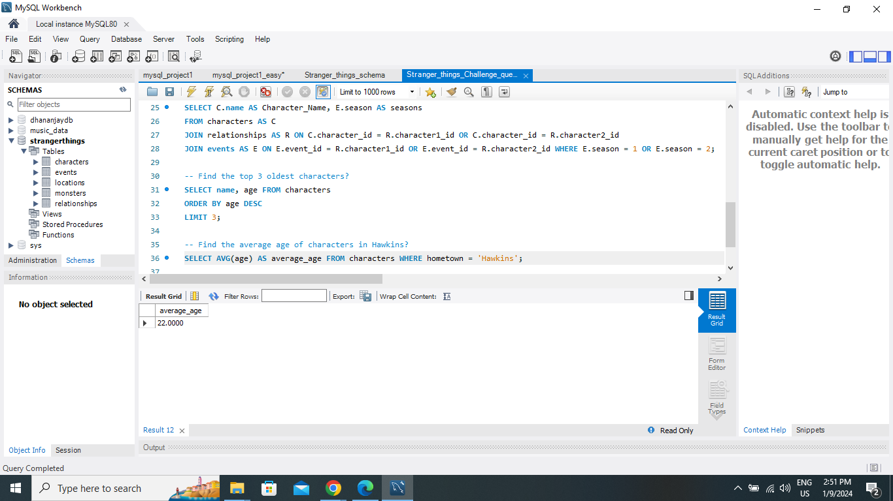
Find the average age of characters in Hawkins?
OUTPUT
SELECT AVG(age) AS average_age FROM characters WHERE hometown = 'Hawkins';
Prepared by
Dhananjay Nimje

Slide 12
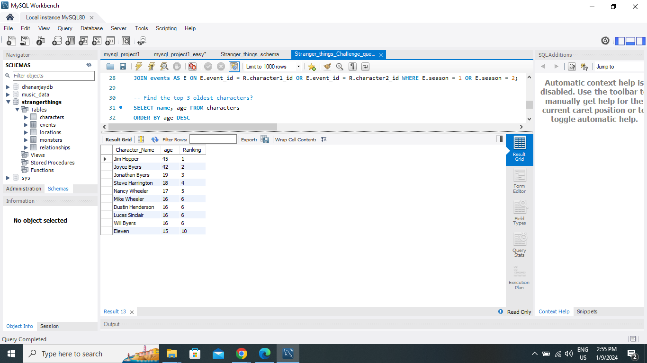
Rank characters by age in descending order?
OUTPUT
SELECT C.name AS Character_Name, C.age, RANK() OVER(ORDER BY C.age DESC) AS Ranking FROM characters AS C;
Prepared by
Dhananjay Nimje

Slide 13
Thank You

